Slide 1
Capacity management tool
Define new job

Slide 2
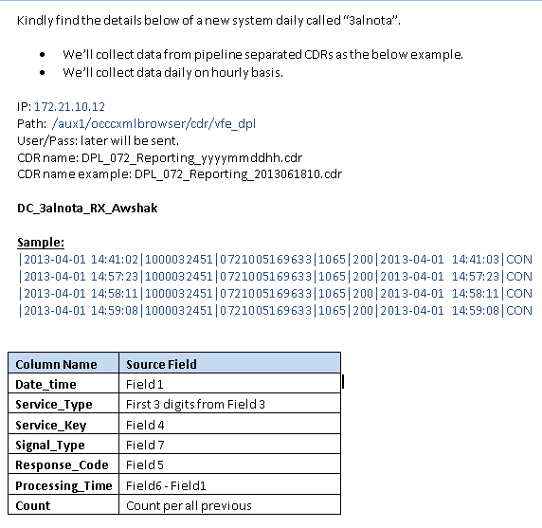
Data collection Job specifications

Slide 3
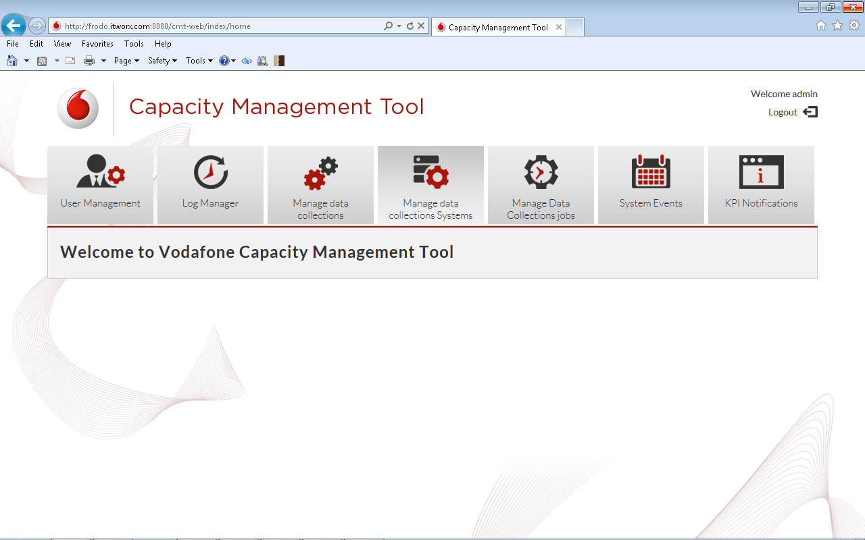
Open define Job form
Click “Manage data Collections jobs” tab
1

Slide 4
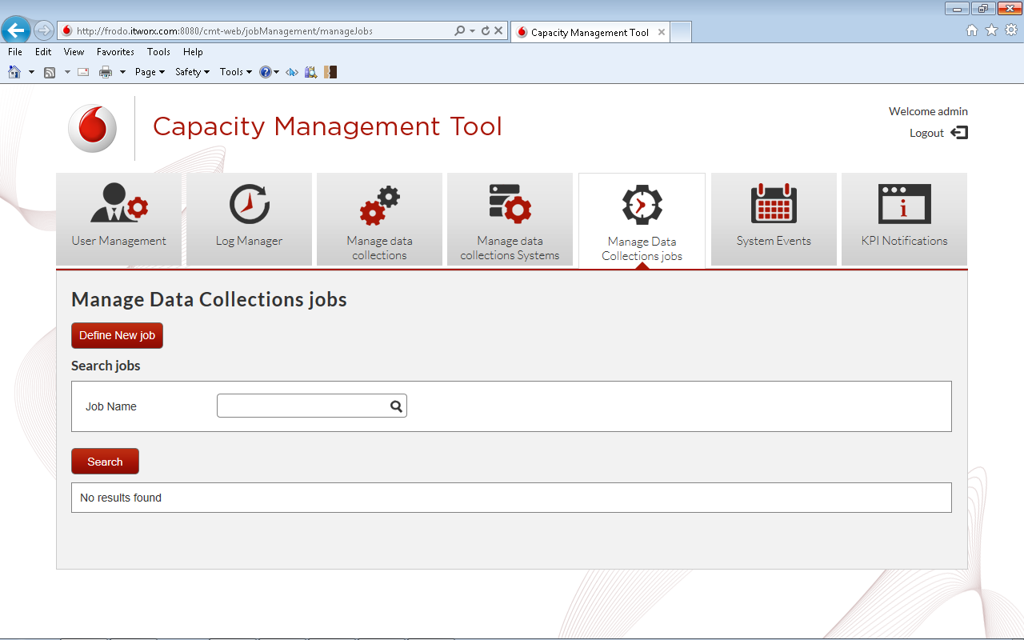
Open define Job form
2
Click “Define New job” button

Slide 5
Define new job form

Slide 6
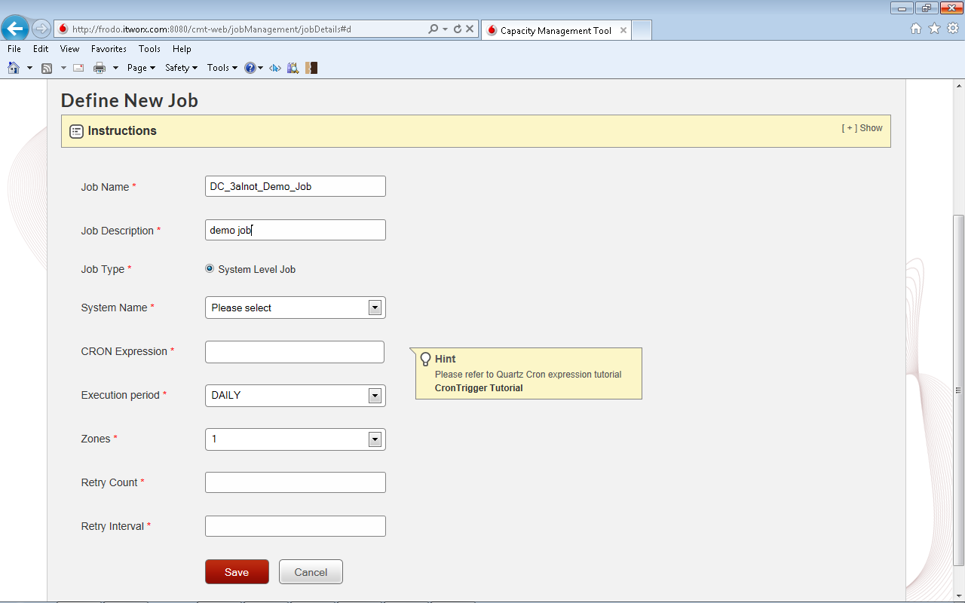
Define job form
1
Type job name
2
Type job description

Slide 7
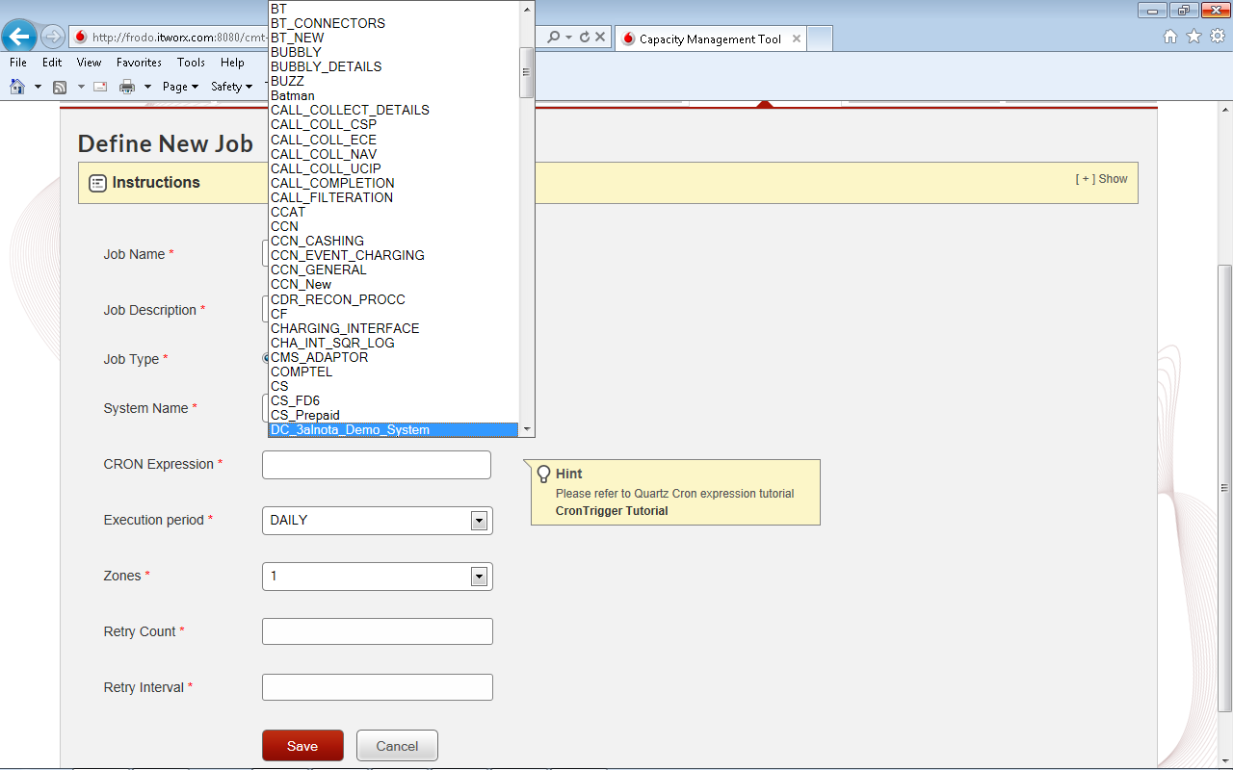
Define job form
Select system
3

Slide 8
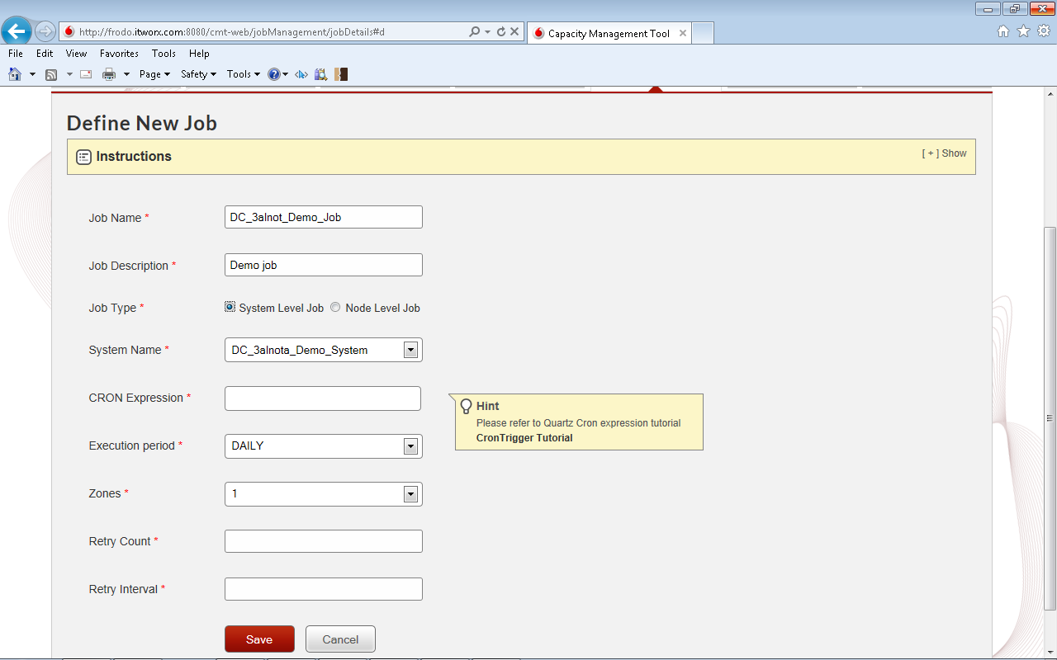
Define job form

Slide 9
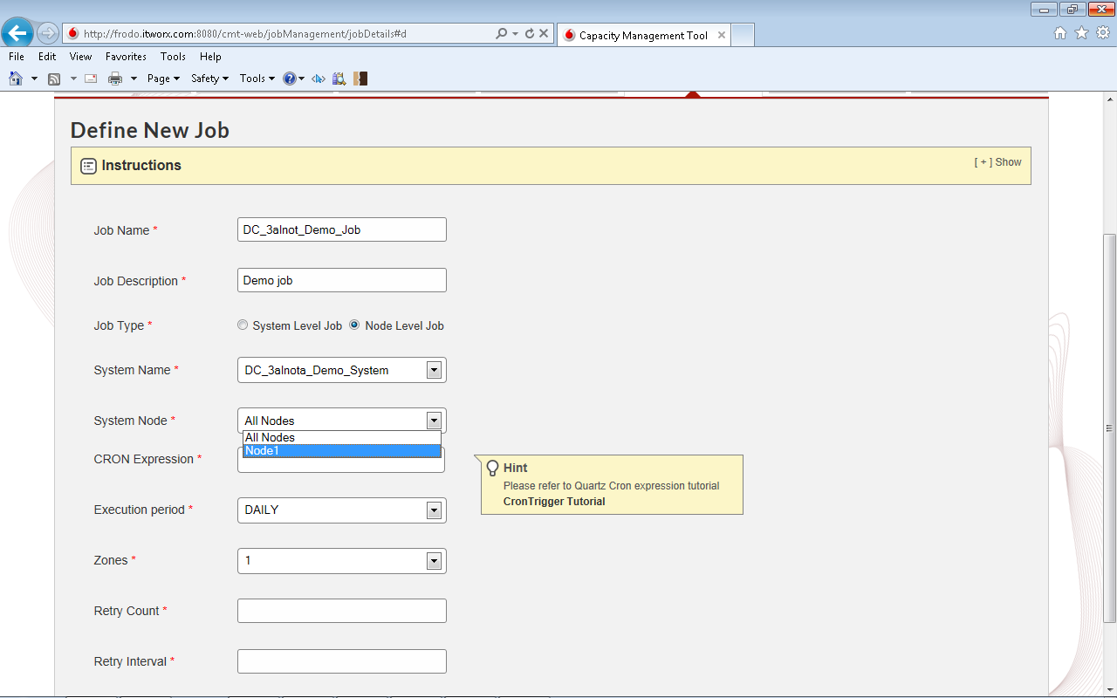
Define job form
Select “node level” option
4
5
Select node

Slide 10
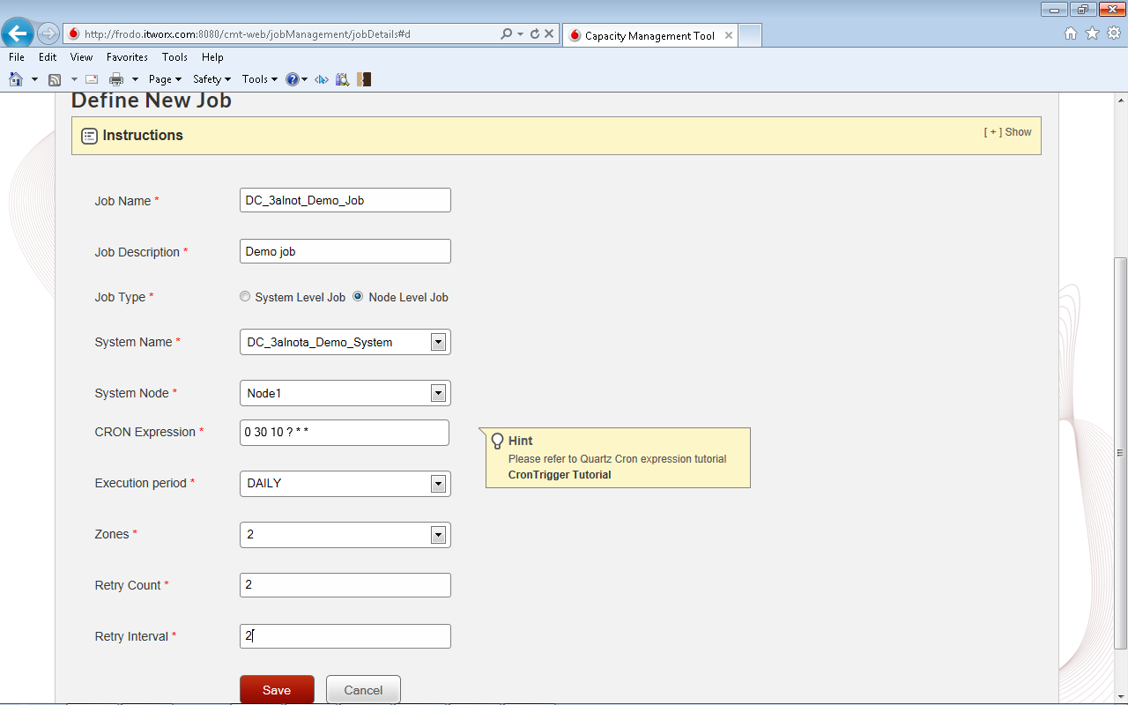
Define job form
Type CRON expression
4
Select Execution period “Daily”
5
6
Select Zone
7
Set retry count and retry interval values
Click save
8

Slide 11
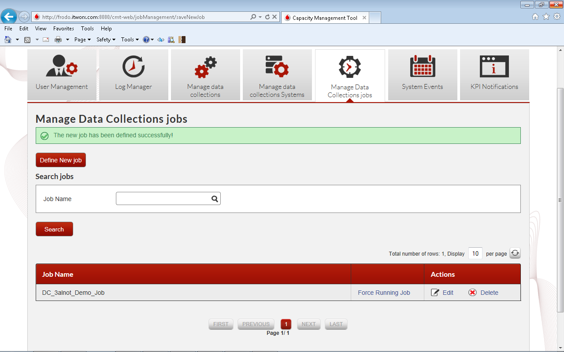
Done

